Slide 1
Evaluating Reservoir Operation Rules to Improve Hydropower Production and Reduce Unmet Water Demands: A case study in the Bear River Basin Using the Water Evaluation and Planning (WEAP) System
Prasanna Dahal¹ and Ryan James¹
[1] Graduate Student, Department of Civil and Environmental Engineering, Utah State University, Logan, UT 84332.
Notes:
Ryan

Slide 2
Presentation Outline
Introduction - stakeholder, the three reservoirs (Soda, Grace, Oneida)
Problem Description - defining reservoir operation
WEAP Model: physical characteristics, objective and the performance metric -
Assumptions
Testing Scenarios
Results - Solution Alternatives
Other groups performance metrics
Conclusion

Slide 3
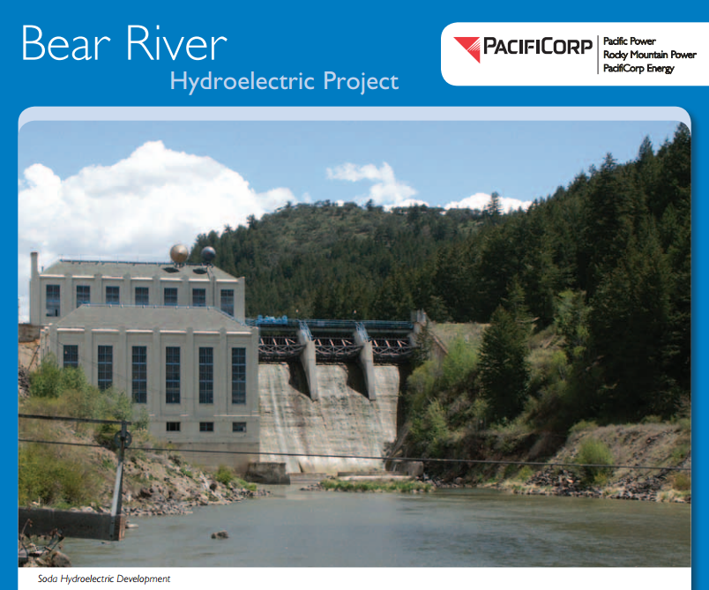
Introduction: Stakeholder
PacifiCorp is one of the west's leading utilities, serving approximately 1.8 million customers in six states.
The Bear River Project (FERC No. 20) is located in along the Southeast Idaho, NorthWest Utah border.
The Bear River Project is largely dependent on the Bear Lake Irrigation Project to pump water from Bear Lake into the lower river.
Grace Hydroelectric Development
Soda Hydroelectric Development

Slide 4
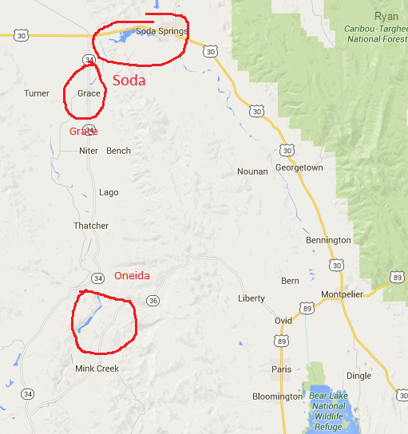
Introduction: Demand Sites
The Bear River Project consists of:
The Soda (Alexander) Development - a 103-foot-high concrete dam, reservoir capacity of 16,300 ac-ft, and a powerhouse with a total installed capacity of 14 MW.
The Grace Development – a 51-foot-high timber crib dam, a 250 ac-ft forebay, a and a powerhouse with a total installed capacity of 33 MW.
The Oneida Development – a 111-foot-high concrete dam, reservoir capacity of 10,880 ac-ft, and a powerhouse with a total installed capacity of 30 MW.

Slide 5
Introduction: Problem Description
Reservoir are considered fill-and-spill.
No established reservoir operation rules
Potential to increase hydropower, and reduce downstream demand with the conjunctive use of the three cascading reservoirs
Notes:
(This might be assumed, we never got a straight answer from PacifiCorp)
Prasanna

Slide 6
Objectives
Evaluate and recommend the reservoirs operational policies to..
Improve hydropower generation, and
Decrease unmet water demand for downstream users.
Performance Metrics
Hydropower generation (MW-hr) by all three reservoirs
Unmet Water demand (for all d/s demand sites)
Solution Approach: Change Reservoirs Operational policies-
Top of Buffer
Top of Inactive
Buffer Coefficient
Reservoir filling order
Notes:
This includes suggestions on the values of reservoir parameters such as reservoir filling priority, top of buffer, buffer coefficient, etc. to adopt to improve hydropower production, or to decrease downstream demand sites’ unmet water demand.
Res. Op. policies include ….
A combination of these parameters for the set of res.

Slide 7
Model Description (Reference Scenario)
Parameters Soda Grace Oneida Unit .
Storage capacity 16300 320 10800 Acre-feet
Res. filling priority 10 10 10 -
Maximum turbine flow 2624 2880 3290 feet³/s
Tailwater elevation 5641 4870 4760 feet
Plant efficiency 86% 86% 86% Percentage
Volume elevation ✓ ✓ ✓ -
Net evaporation ✓ ✓ ✓ -
Assumed Values,
based on Hydropower production
Data present, but not shown
because these are series data

Slide 8
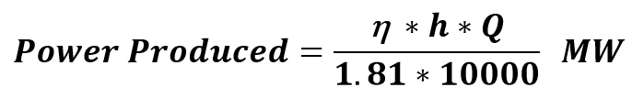
Assumptions
Tailwater elevations, to match real power production potential.
Excluded multiple demand sites
Due to inadequate data
Evaporation rate assumed same for the three reservoirs
Because they are close to each other
Volume- Elevation curve
Assumed based on other reservoir data
Water rights
Refil and and drawdown period assumed Oct-March, and Drawdown May-Nov
Headflow
Assumed the same headflow for bear river, as class model
Neglected the diversion and inflow of water in between the reaches
Notes:
There were multiple assumptions because we were unable to get the data for the three sites. PacifiCorp seem to have a strict policy regarding data distribution.
Power produced formula (for flow in CFS) was used to get h, which helped find tailwater elevation
Excluded for lack of data such as return flow, and seasonal variability

Slide 9
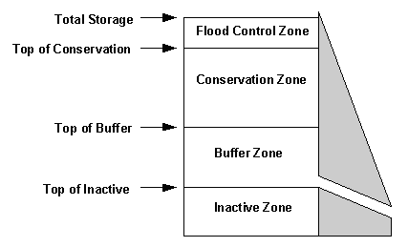
Scenarios: Testing Elements
Priority Number
3 scenarios. Testing high (1), low (99), and monthly change
Top of Inactive
5 scenarios. Each set to a lower volume level starting with capacity.
Top of Buffer and Buffer Coefficient
25 scenarios. Each set to a lower volume level starting with capacity.
Buffer Coefficient Range (1.0, 0.75, 0.50, 0.25, 0.10)
Solution Alternatives
3 scenarios. Looking to 1) Max Hydropower, 2) Min Unmet Water Demand, 3) Tester favorite
Notes:
Ryan
Descript scenario here, descript results on next slides

Slide 10
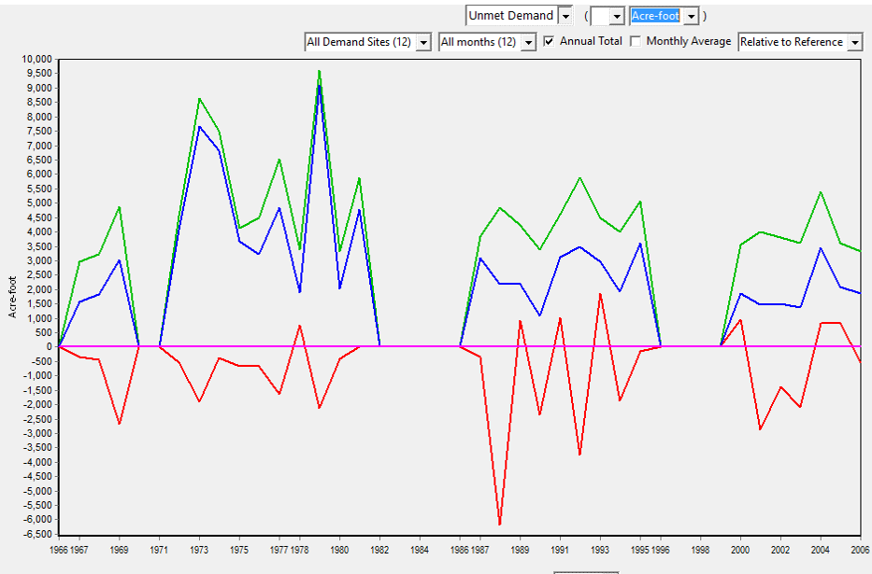
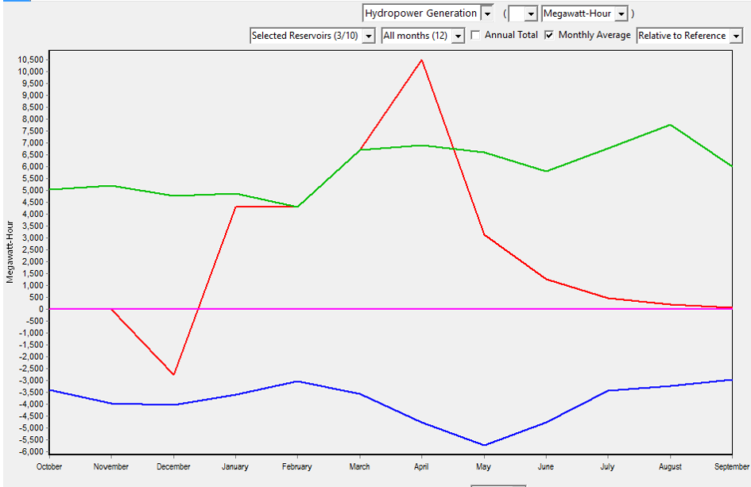
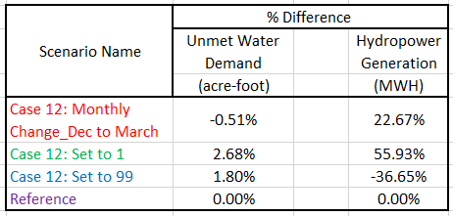

Scenarios: Priority Number Results
Plot Legend
Notes:
These are the wrong results

Slide 11

Scenarios: Priority Number Results
Unmet Water Demand
Plot Legend
Hydropower Generation
Notes:
These are the wrong legend

Slide 12
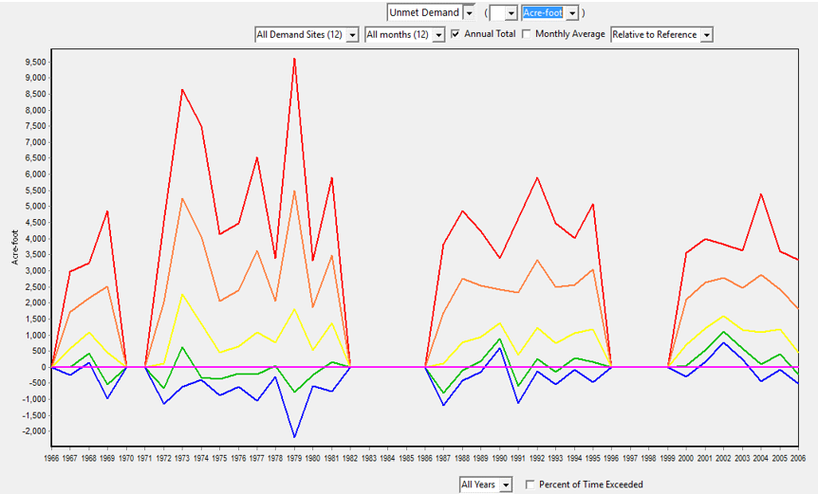
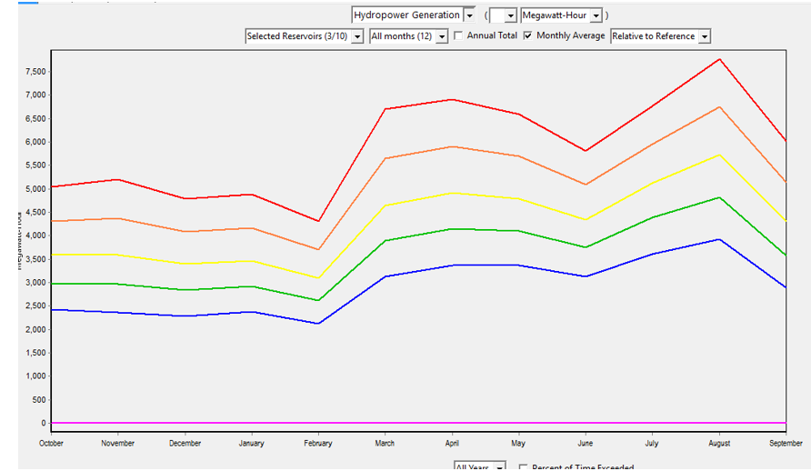
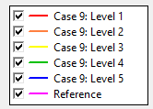
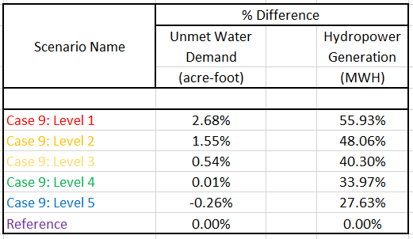
Scenarios:
Top of Inactive Results
Unmet Water Demand
Hydropower Generation
Plot Legend

Slide 13
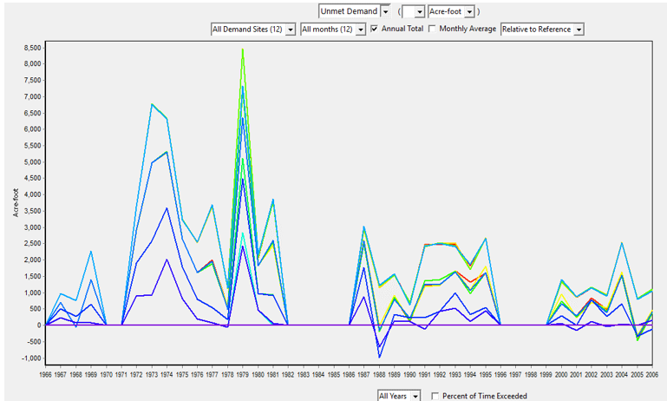
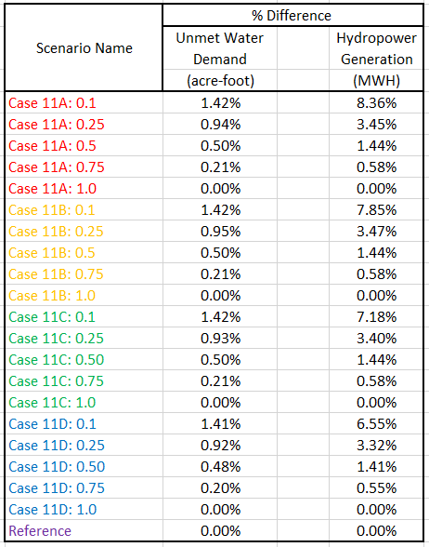
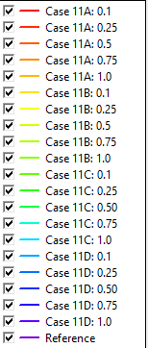
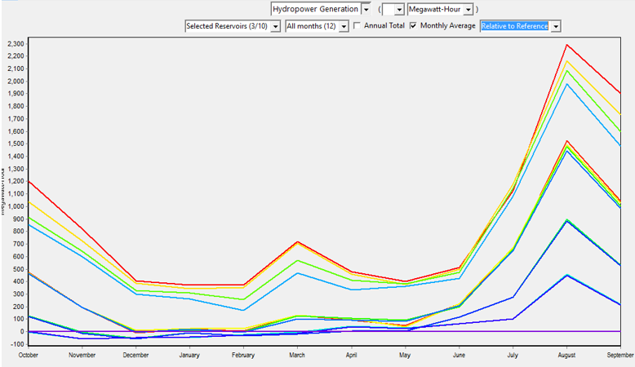
Scenarios:
Top of Buffer & Buffer Coefficient Results
Unmet Water Demand
Plot Legend
Hydropower Generation

Slide 14
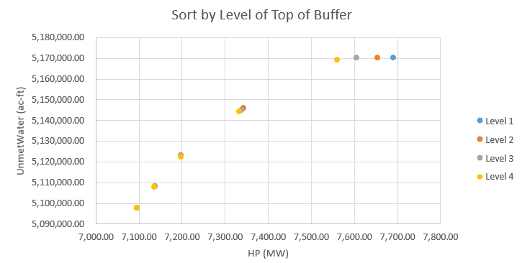
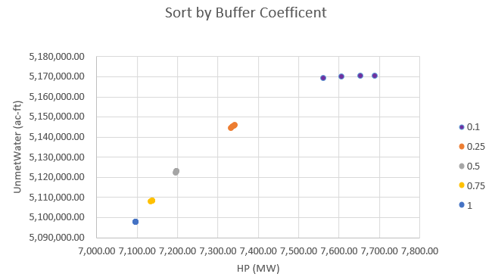
Scenarios:
Top of Buffer & Buffer Coefficient Results (CONT’D)
Min (ac-ft)
Take Away:
Difference in results had very little to do with Top of Buffer volume level, which could be set to any level and still have roughly the same results.
Buffer Coefficient has much more influence than Top of Buffer volume level for our system.
Discussion:
Water Demand is too high on system.
Max(MWH)
Min (ac-ft)
Max(MWH)

Slide 15
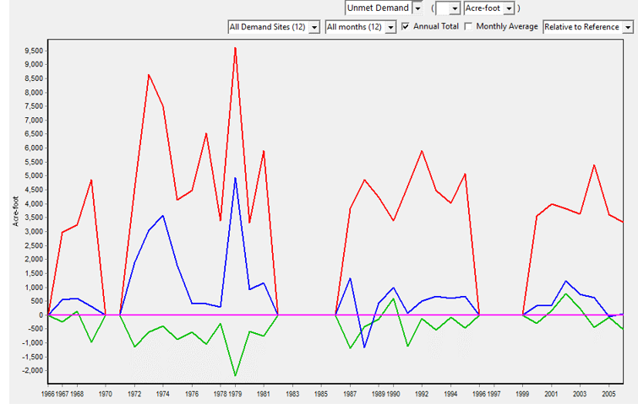

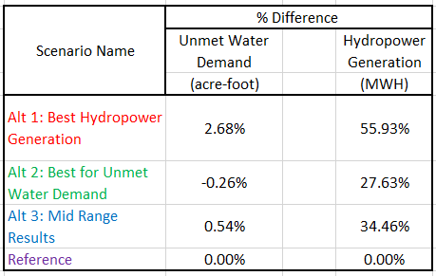
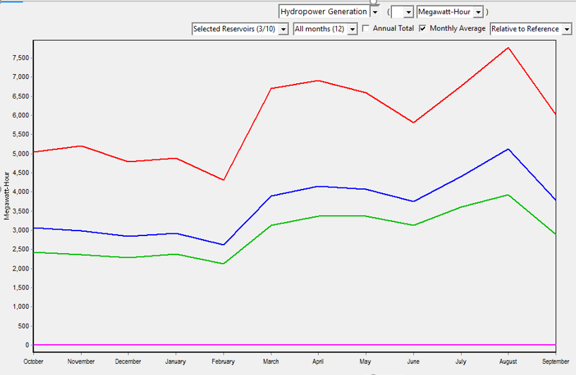
Scenarios:
Solution Alternative Results
Unmet Water Demand
Plot Legend
Hydropower Generation

Slide 16
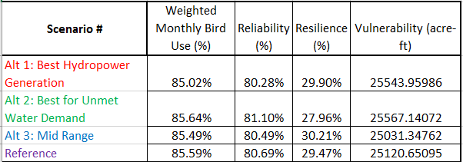
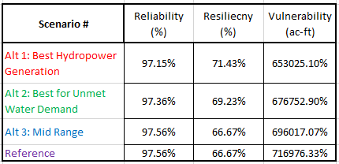
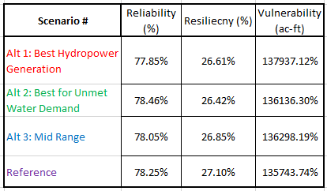
Quick shout out to Other Groups Performance Metrics to our Solution Alternatives
BRMBR
BRCC
Logan City

Slide 17
Quick shout out to Other Groups Performance Metrics to our Solution Alternatives

Slide 18
Discussion & Conclusion
Reservoirs are better for Hydropower Generation than for Unmet Water Demand.
Different combinations of reservoir parameters were tested to successfully:
Increase hydropower energy generation
Decrease unmet demand
We found that
Buffer coefficient is important
Low - better hydropower
More - better to meet water demand
Reservoir operation rules to meet different objectives were recommended
Notes:
The test was to to determine a set of rules for

Slide 19
Questions?

